Slide 1
IST687 Project Update 2
Agile Kanban Methodology
Team 001
Alex Hyman, Spalding Lewis, David Mackey, Olga Perera

Slide 2
Kanban Board
BACKLOG | IN-PROGRESS | ANALYSIS | DEPLOYED
Develop a workflow plan | Dig deeper past initial findings Decide what questions should be focused on Implement robust statistical methods for analysis | Analyze relationship between Churn and factors including demographic, purchased contract, and optional services | Determined initial business questions to be tested Found a dataset to analyze Assign initial tasks

Slide 3
Kanban Board Link
Trello Link
https://trello.com/b/R3j3QUAD/ads-project-board

Slide 4
Overall Summary
Accomplishments this past period
Identified candidate variables
Created meaningful visualizations
Began initial analysis of some descriptive and inferential statistics
What is working well
Active Participation
Team collaboration
Communication
Plans for next update
Discussion: Are all the candidate variables needed for building the most effective model
Discussion: Could it be beneficial to build a totally different model for those with internet service and those without?
Issues / What is not working well
Developing model due to lack of exposure
Translating analysis into actionable insights due to lack of model
Data Understanding | Preprocessing | Analysis | Testing | Communicating Results
10% of time / 4 people | 25% of time / 4 people | 35% of time / 4 people |  | 30% of time / 4 people

Slide 5
Dataset Summary
Telco Customer Churn
Customer data from a telecommunications company
Includes account and demographic information
Gender, Partnered, Senior citizen, Dependents
Internet, Phone, Tech support services
Potential decision-making (dependent) variables:
Churn
Total Charges
Tenure

Slide 6
Important Business Questions
What demographics (if any) are most likely to be churn?
Senior citizens have high churn rate
Are there any potentially untapped demographics?
Potentially middle income/non-premium
Are there any trends in when churned customer are leaving?
Mean tenure of churned customers: 18 Months
Median tenure of churned customers: 10 Months
Large positive skew
Does any contract type perform significantly better compared to other options?
Majority of churn is due from month-to-month contracts
Where should we focus our resources to increase retention rate?

Slide 7
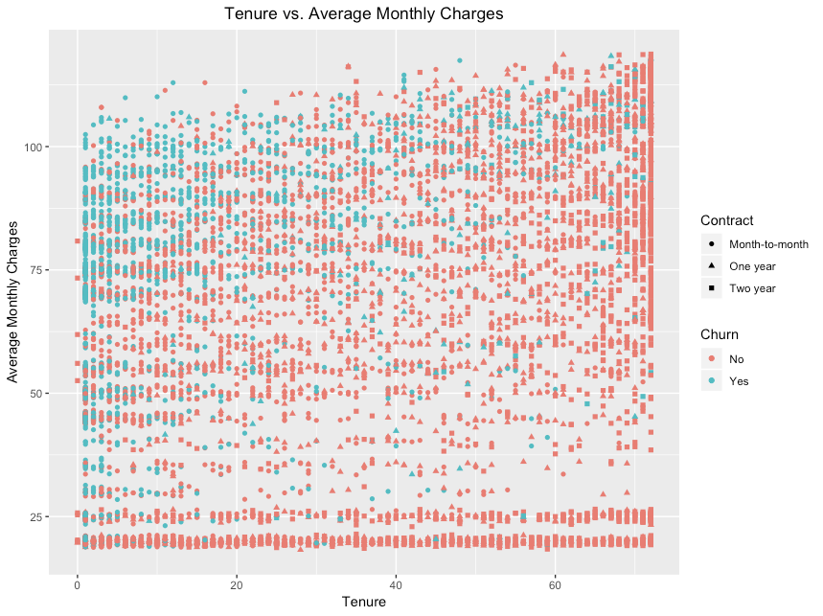
Visualizing Churn
Customers who have higher monthly bills are more likely to leave
The longer a customer has been with the company, the less likely they will leave
There appears to be a positive sloped diagonal line that acts as a boundary separating retained and churned customers
Appears to be a gap in average monthly bill between $25 and $50. Could be a customer base that is interested in an upgraded plan from the minimum

Slide 8
Comparing Contracts (1)
Two Year Contracts both have the longest tenures and have made the most money
More investigation is needed into lurking variables
Contract Type | Total Money Received
Month-to-Month | $5,305,862
One Year | $4,467,054
Two Years | $6,283,254
Contract Type | Average Tenure (mo.) | Tenure SD (mo.)
Month-to-Month | 18.0 | 17.7
One Year | 42.0 | 19.0
Two Years | 56.7 | 18.2

Slide 9
Comparing Contracts (2)
Observed
Chi Square test for independence shows a relationship between churn and contracts (p-value <2.2e-16)
The long-term contracts have better customer retention than expected
Maybe focus on a push towards long-term contracts
 | Churn - No | Churn - Yes
Month-to-Month | 2220 | 1655
One Year | 1307 | 166
Two Years | 1647 | 48
Expected
 | Churn - No | Churn - Yes
Month-to-Month | 2846.7 | 1028.3
One Year | 1082.1 | 390.9
Two Years | 1245.2 | 449.8

Slide 10
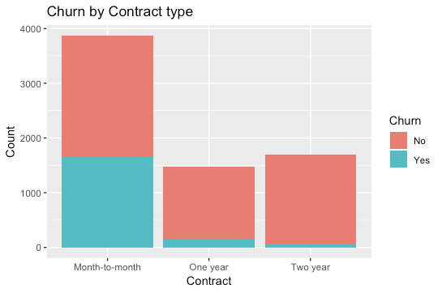
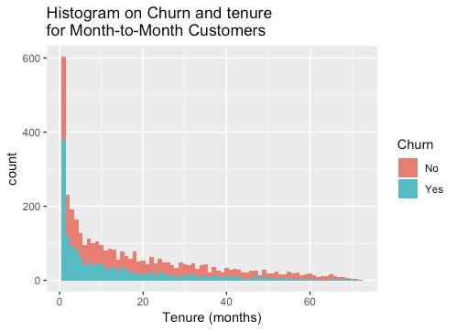
Comparing Contracts (3)
Majority of contracts are on month-to-month
Low churn rate in both one year and two year contracts
Deeper analysis in month-to-month contracts is required
Potential solution is to push customers more toward the long-term contracts
Early intervention potentially needed for month-to-month customers

Slide 11
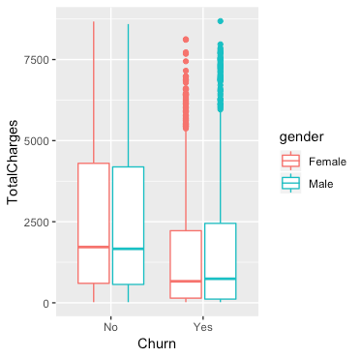
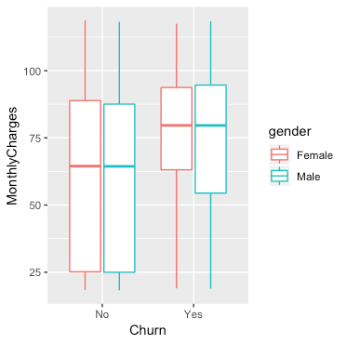
Churn, Charge Rates, and Gender

Slide 12
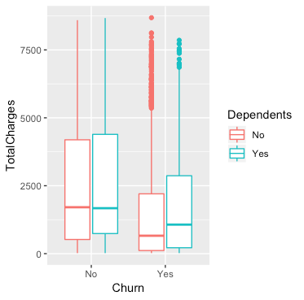
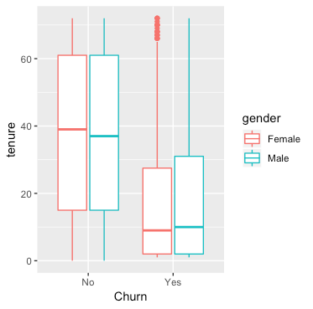
Churn, Charge Rates and Dependents

Slide 13
Churn Rate for Senior Citizens
The churn rate was observed to be higher for senior citizens than non-seniors.
A t-test shows that the difference in the churn rates is statistically significant (p-value < 2.2e-16
Category | Churn Rate | n
Non-Seniors | 23.61% | 5,901
Seniors | 41.68% | 1,142

Slide 14
High Impact Services
Extra Services seem to have little effect on churning customers
This could lead us to spending less on selling the extra services
Service | Percent Churn (%)
Phone Service | 90.9
Online Security | 5.3
Online Backup | 9.5
Device Protection | 9.9
Tech Support | 5.6

